Slide 1
Artificial Intelligence in Real Time Strategy Games
Dan Li

Slide 2
Basic Concepts
2 player adversarial
Everything happens in real-time
Millions of actions to choose from
Opponent acts against you
A logical frame is a unit of game time.
24 frames per second.
Average game lasts around 15 minutes.

Slide 3
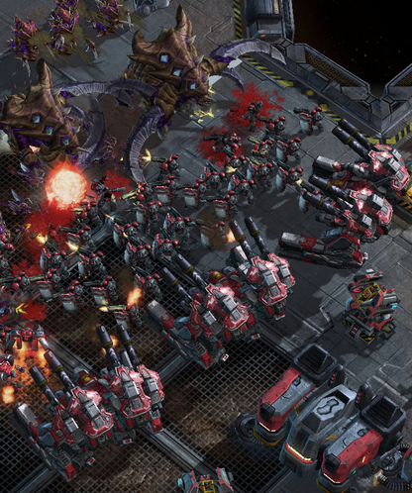
Unit Type
Attack
Range
Damage per second
Health
Movement Speed
Production time and cost
Type (Air/Ground)
Can be controlled individually or in groups
May counter specific other unit types

Slide 4
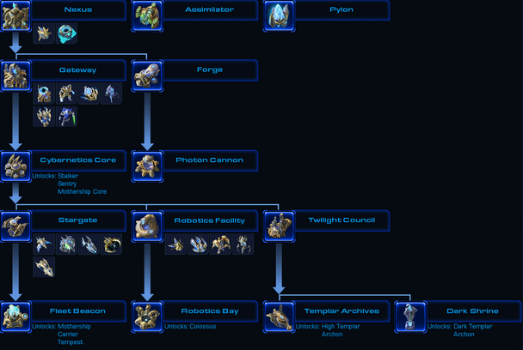
Workers
Harvest Resources
Construct Buildings
Buildings
Production or Technology
Enable construction of buildings or certain types of units
Build orders
Construction time and cost.

Slide 5
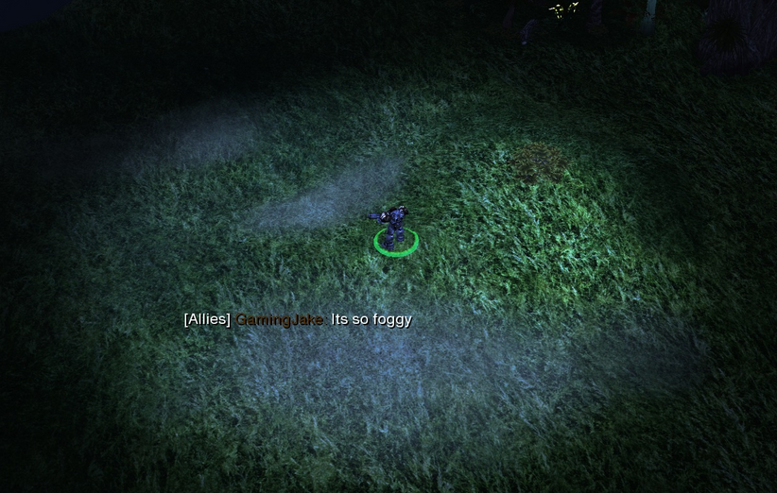
Fog of war
Presence of player’s units and buildings lend sight to surrounding areas
Requires active scouting to gather info on opponent
Imperfect information

Slide 6
AI in RTS Games
Artificial Intelligence and Interactive Digital Entertainment Conference (AIIDE).
Started in 2010, in the spirit of Deep Blue.
Bots compete in various aspects of gameplay, culminating in full game.
Bots use BWAPI and PyMS.
Best Starcraft bots ranked D+ (slightly above average) in iCCup
Notes:
Revisit main challenge

Slide 7
Challenges
Simultaneous events, many possible actions, but limited time to think.
Opponent can exploit scripted actions.

Slide 8
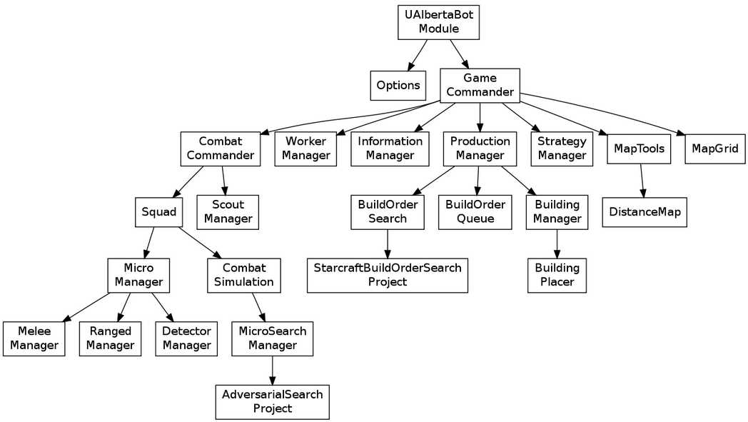
UAlbertaBot
Notes:
Military command structure.
Game commander makes strategic decisions.
Commands issued to sub commanders.
Sub commanders in charge of completing low-level tasks.
Modular: (e.g. replace script-based production manager with search based)

Slide 9
Scouting
Goal: collect observation about opponent.
Approach: Identify valuable scouting targets. Move a unit as close as possible to each target without dying. Make note of enemy buildings and unit types.
Threat-aware path planning.
Incorporate threats into search graph as costs.
Also useful for planning assaults.
Notes:
Offline learning for predicting opponents build order based on units scouted

Slide 10
Strategy Prediction
Predict opponent’s strategy using partial observations made by the scouting agent.
Employs a model (e.g. Bayesian network) built using offline learning:
Analyze pro-gamer replays to correlate strategy, build order, units and time.

Slide 11
Macro Management
Goal: Align production, technology and economy to fulfill a determined strategy.
Approach: Determine unit composition and buildings is needed by when. Plan economy and production to achieve in shortest amount of time.
Rule-based or planning agents.

Slide 12
Micro Management
Control a squad of unit to optimize ROI in combat.
Techniques:
“Attack weakest enemy in range”
Minimax (with iterative deepening and heuristics) for targeting.
Potential fields, with machine learning to tune parameters.
Notes:
Minimax for targetting
Automaton- if a marine is near, attack it if it has less than X hp Heuristic search for micro

Slide 13
Conclusion
Starcraft AI has many areas of improvements to match humans in full-blown game play.
Rationality of a good AI is not scripted, but an emergent behavior from collaborating agents.

Slide 14
Resources
Churchill, David, and Michael Buro. "Incorporating Search Algorithms into RTS Game Agents." Eighth Artificial Intelligence and Interactive Digital Entertainment Conference. 2012.
Churchill, David, Abdallah Saffidine, and Michael Buro. "Fast heuristic search for RTS game combat scenarios." Proceedings of AIIDE,(pre-print available at www. cs. ualberta. ca/mburo/ps/aiide12-combat. pdf (2012).
StarCraft AI Competition UAlbertaBot
Skynet meets the Swarm: how the Berkeley Overmind won the 2010 StarCraft AI competition
AIIDE Starcraft Competition

